Slide 1






Project Name:
“Complaint, NSTU”

Slide 2
Presented By
Mohammad Borhan Uddin
ID: ASH2101008M
MD. Billal Hossain
ID: MUH2101028M

Slide 3
Submitted To
Sharmin Akter Milu
Lecturer,
Department of Computer Science and Telecommunication Engineering,
Noakhali Science & Technology University.

Slide 4

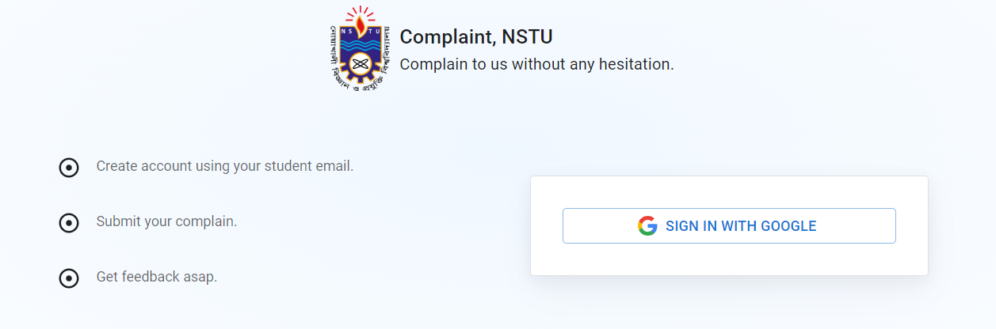

Introduction
“Complaint, NSTU” is a web-based application designed to simplify the complaint submission process for university students. It allows students to submit, track, and manage complaints, while administrators can monitor and resolve these complaints efficiently, enhancing communication between students and university authorities​.

Slide 5


Problem It Solves
Traditional systems lack transparency, making it difficult for students to track the status of their complaints, and often result in delays or mismanagement.
Goals of the Project
Simplify the process for students to submit complaints.
Help admins manage and resolve complaints efficiently.
Provide real-time updates to students on their complaint status.
Improve communication between students and university staff.

Slide 6
Features
Students
Admin
Log in with university credentials.
Submit complaints easily through the platform.
Track the real-time status of submitted complaints. (Pending, Accepted, Rejected)
View a history of all previous complaints.
Update personal information, such as department and contact details.
Access a list of all student complaints.
Promote a user to admin and block users..
Filter and sort complaints by department, batch, status, and date.
Update the status of complaints and notify students.
Add comments to complaints for student updates or feedback.

Slide 7






Technologies
Frontend
ReactJS : Building the user interface for both students and admins.
Material-UI: Framework for designing modern, user-friendly, and accessible UI
Backend
Node.js and Express.js: Handle server-side logic, API development and others.
MySQL: A relational database used to store and manage data.
Authentication
Firebase Authentication: Used for secure user authentication.

Slide 8


Q & A

Slide 9
Thank you!

